Slide 1
CNN Architectures
Instructors: Balaji Srinivasan & Ganapathy krishnamurthi

Slide 2
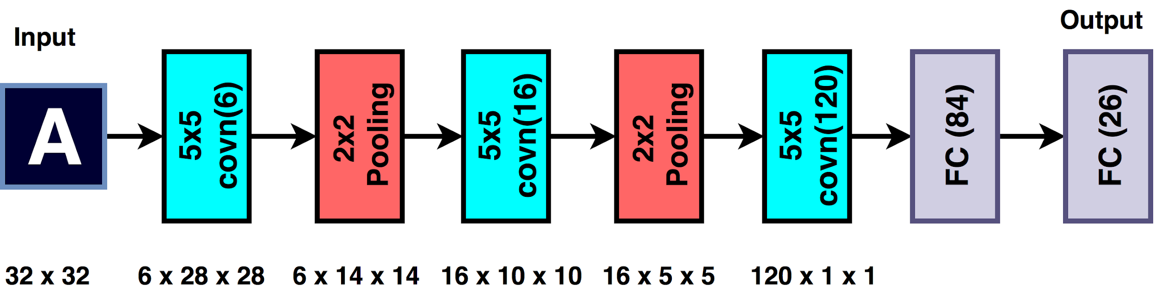
LeNet- Digit Classification
Among the earliest CNNs to be used for digit recognition
Based on multiple convolution and average pooling layers
Number of Parameters
Y. LeCun, L. Bottou, Y. Bengio, and P. Haffner,Gradient-based learning applied to document recognition, Proc. IEEE 86(11): 2278–2324, 1998

Slide 3
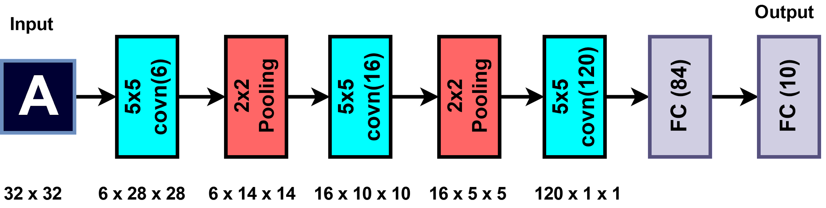
LeNet- Digit Classification
Among the earliest CNNs to be used for digit recognition
Based on multiple convolution and average pooling layers
Number of Parameters
Y. LeCun, L. Bottou, Y. Bengio, and P. Haffner,Gradient-based learning applied to document recognition, Proc. IEEE 86(11): 2278–2324, 1998

Slide 4
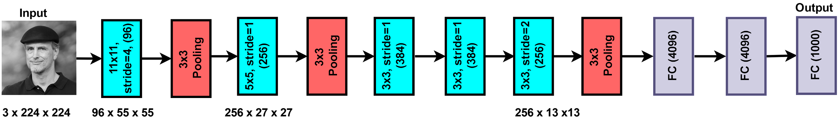
AlexNet
Trained on 2 GPUs
60 Million Parameters
Overlapped Max pooling
Dropout regularization
7 Layers including convolution and densely connected
GPUs Communicate only in certain layers
Layer Normalization
A. Krizhevsky, I. Sutskever, and G. Hinton, ImageNet Classification with Deep Convolutional Neural Networks, NIPS 2012
Image Courtesy: https://upload.wikimedia.org/wikipedia/commons/c/c5/Juergen.jpg

Slide 5
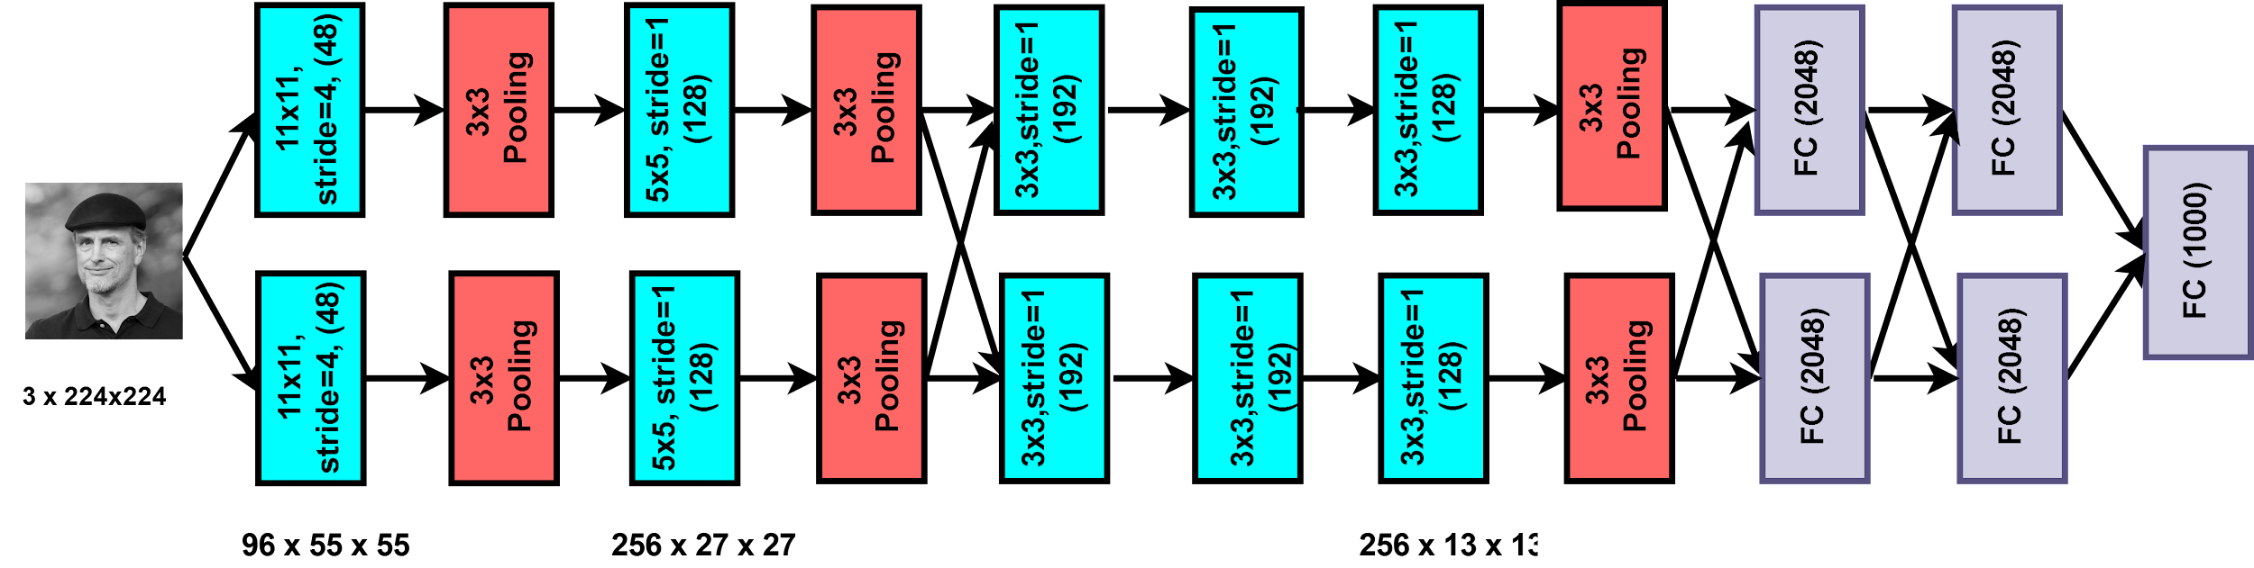
AlexNet
Image Courtesy: https://upload.wikimedia.org/wikipedia/commons/c/c5/Juergen.jpg
A. Krizhevsky, I. Sutskever, and G. Hinton, ImageNet Classification with Deep Convolutional Neural Networks, NIPS 2012

Slide 6
AlexNet
Image Courtesy: https://upload.wikimedia.org/wikipedia/commons/c/c5/Juergen.jpg
A. Krizhevsky, I. Sutskever, and G. Hinton, ImageNet Classification with Deep Convolutional Neural Networks, NIPS 2012

Slide 7
AlexNet
Image Courtesy: https://upload.wikimedia.org/wikipedia/commons/c/c5/Juergen.jpg
A. Krizhevsky, I. Sutskever, and G. Hinton, ImageNet Classification with Deep Convolutional Neural Networks, NIPS 2012

Slide 8
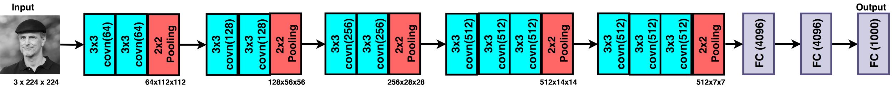
VGG
Developed by Simonyan and Zisserman for ILSVRC 2014 competition.
VGGNet consists of 16 convolutional layers with only 3x3 kernels
The design opted by the authors are similar to Alexnet i.e. increase the number of the features map or convolution as the depth of the network increases
The network comprises of 138 million parameters.
VGG 16
Image Courtesy: https://upload.wikimedia.org/wikipedia/commons/c/c5/Juergen.jpg

Slide 9
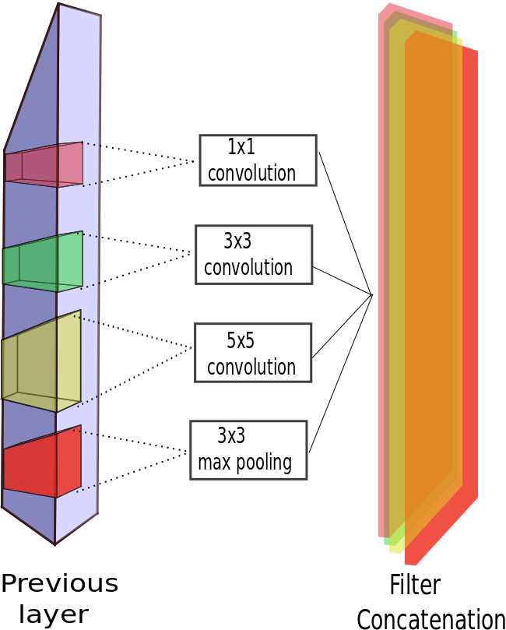
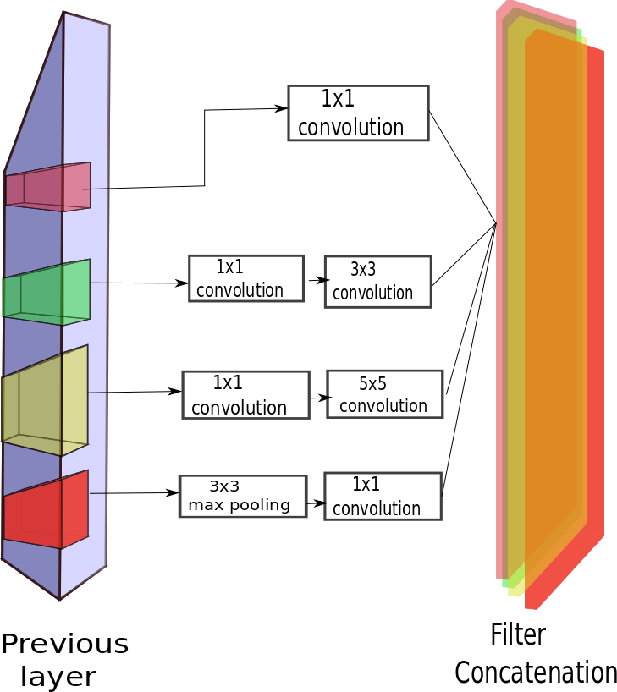
GoogleNet- Inception Module

Slide 10
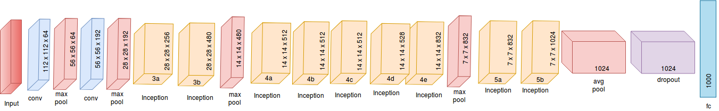
GoogleNet

Slide 11
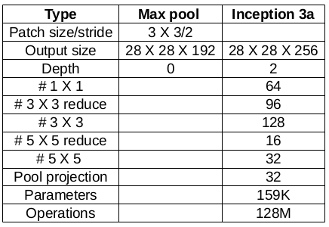
Computations in Inception
Considering only the max-pool layer and inception 3a layer

Slide 12
Computations in Inception
28 x 28 x 192
3 x 3 x 192 @ 128
28 x 28 x 128
No. of operations
=( 3 X 3) X (28 x 28) x 192 X 128
=173,408,256
=173 M
max pool
3 x 3
convolution
28 x 28 x 192
28 x 28 x 96
28 x 28 x 128
1 x 1 x 192 @ 96
3 x 3 x 96 @ 128
No. of operations
=( 1 x 1) x (28 x 28) x 192x 96
+ (3 x 3) x (28 x 28) x 96 x 128
=101,154,816
=101 M
1 x 1
convolution
3 x 3
convolution
max pool

Slide 13
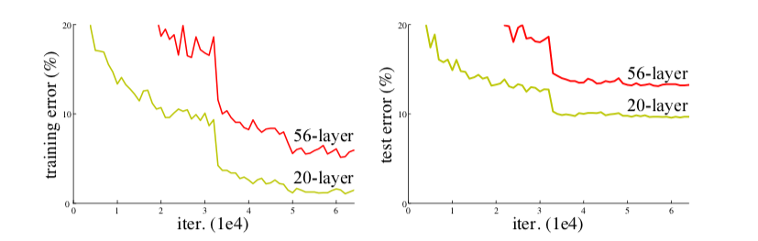
ResNet
Introduced by He et al. at the ILSVRC 2015 competition.
They observed that With network depth increasing, accuracy gets saturated (which might be unsurprising) and then degrades rapidly.
The network comprises of novel approach pathway called skip connection.
These connection provide alternate pathway for data and gradients to flow and thus making training possible.
This connectivity pattern aids in training network with 152 layers while being less complex than VGG.
Training error (left) and test error (right) on CIFAR-10 with 20-layer and 56-layer “plain” networks. The deeper network has higher training error, and thus test error
Image Courtesy: He K, Zhang X, Ren S, Sun J. Deep residual learning for image recognition. InProceedings of the IEEE conference on computer vision and pattern recognition 2016 (pp. 770-778).

Slide 14
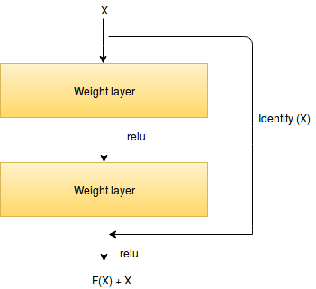
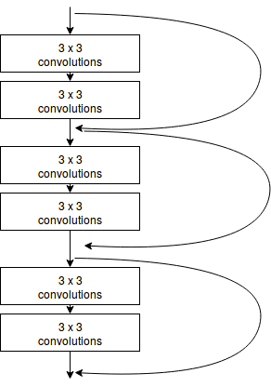
Core Idea of Residual Networks
A deeper network can be made from a shallow network.
This is achieved by copying weights in shallow network and setting other layers in the deeper network to be identity mapping.
This formulation indicates that the deeper model should not produce higher training error than the shallower counterpart.
https://github.com/dyhan0920/PyramidNet-PyTorch

Slide 15
Name of Network | Year | Developed by | Top 5 % | No. of Parameters
LeNet-5 | 1998 | Lecun |  | 60 thousand
AlexNet | 2012 | Alex Krizhevsky | 15.3 | 60 million
VGG-16 | 2014 | Simonyan | 7.3 | 138 million
ResNet | 2015 | Kaiming He | 3.6 | 65 Million

Slide 16
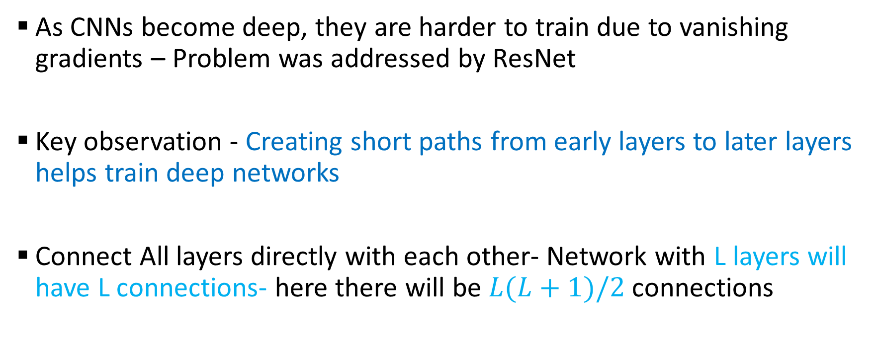
DenseNets- Densely Connected Convolutional Networks
G. Huang, Z. Liu, L. v. d. Maaten and K. Q. Weinberger, "Densely Connected Convolutional Networks," 2017 IEEE Conference on Computer Vision and Pattern Recognition (CVPR), Honolulu, HI, 2017, pp. 2261-2269.

Slide 17
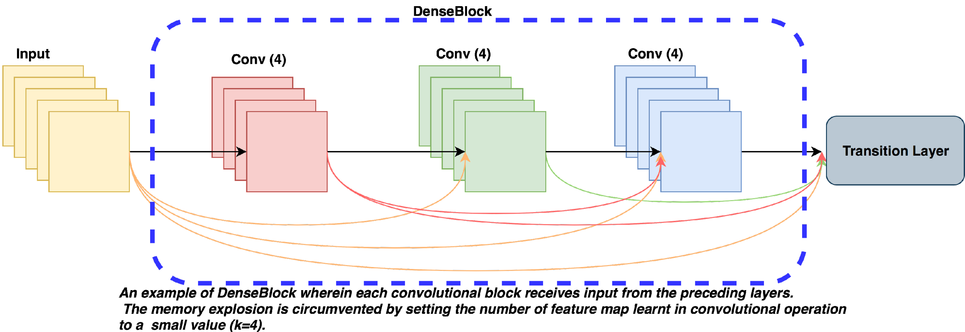
DenseNet Block
G. Huang, Z. Liu, L. v. d. Maaten and K. Q. Weinberger, "Densely Connected Convolutional Networks," 2017 IEEE Conference on Computer Vision and Pattern Recognition (CVPR), Honolulu, HI, 2017, pp. 2261-2269.

Slide 18
DenseNet - Advantages
Parameter efficiency – Every layer adds only a limited number of parameters- for e.g. only about 12 kernels are learnt per layer
Implicit deep supervision- Improved flow of gradient through the network- Feature maps in all layers have direct access to the loss function and its gradient.
G. Huang, Z. Liu, L. v. d. Maaten and K. Q. Weinberger, "Densely Connected Convolutional Networks," 2017 IEEE Conference on Computer Vision and Pattern Recognition (CVPR), Honolulu, HI, 2017, pp. 2261-2269.

Slide 19
DenseNet Architecture- Dense Block
Growth Rate
Dense Connectivity
Transition Layers
Composite Function
G. Huang, Z. Liu, L. v. d. Maaten and K. Q. Weinberger, "Densely Connected Convolutional Networks," 2017 IEEE Conference on Computer Vision and Pattern Recognition (CVPR), Honolulu, HI, 2017, pp. 2261-2269.

Slide 20
DenseNet Architecture
Each Layer outputs k –feature maps, k is the growth factor
Bottleneck Layer of 1x1 followed by 3x3 convolutions- 1x1 convolutions output 4k feature maps
Initial conv Layer outputs 4k Feature maps, for ImageNet the initial conv layer outputs 2k feature maps

Slide 21
DenseNet for ImageNet Challenge
Layers | Output size | DenseNet-121,k=32
Convolution | 112x112
Pooling | 56x56
Dense Block 1 | 56x56 | [1x1->3x3]x6
Transition layer 1 | 56x56-> 28x28
Dense Block 2 | 28x28 | [1x1->3x3]x12
Transition Layer 2 | 28x28-> 14x14
Dense Block 3 | 14x14 | 1x1->3x3]x 24
Transition Layer 3 | 14x14->7x7
Dense Block 4 | 7x7 | 1x1->3x3]x16
Classification Layer | 1x1 | 7x7 GAP-> 1000 Fully Connected softmax

Slide 22
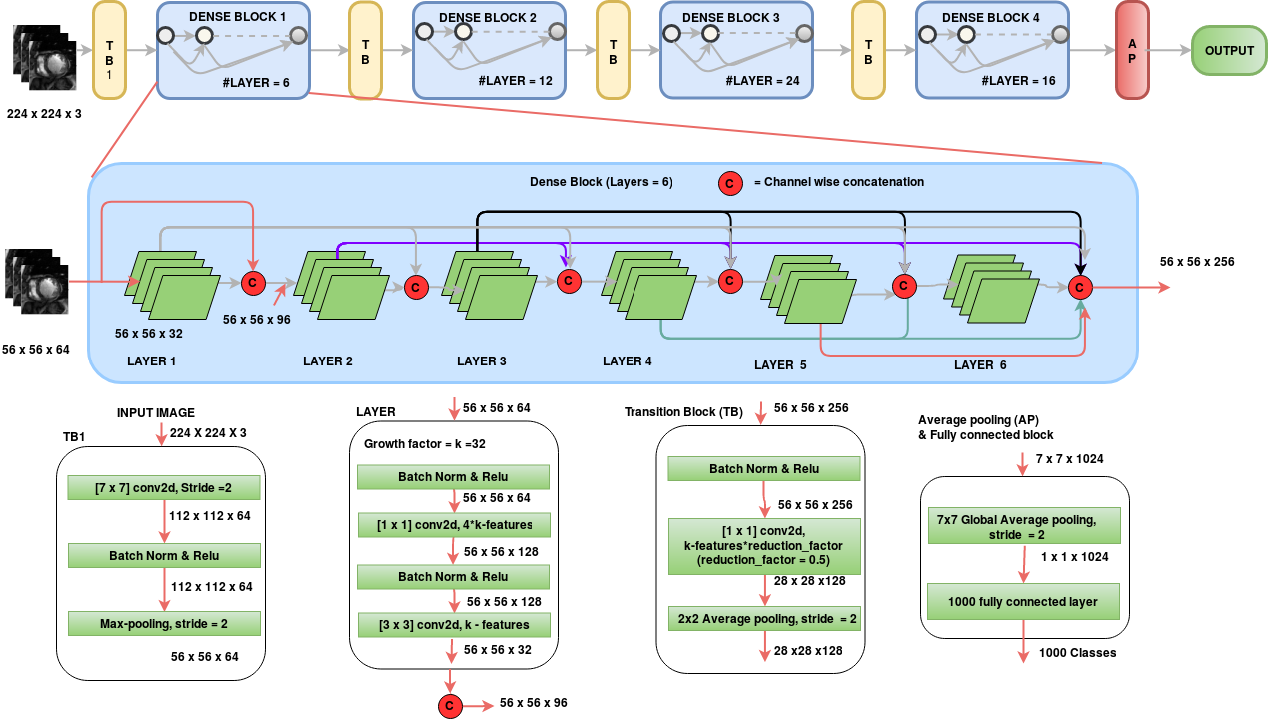
DenceNet

Slide 23
Semantic Segmentation

Slide 24
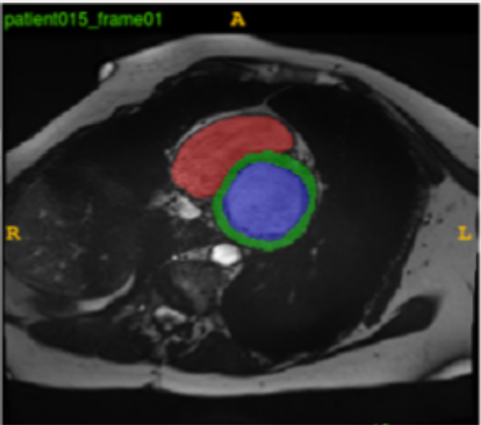
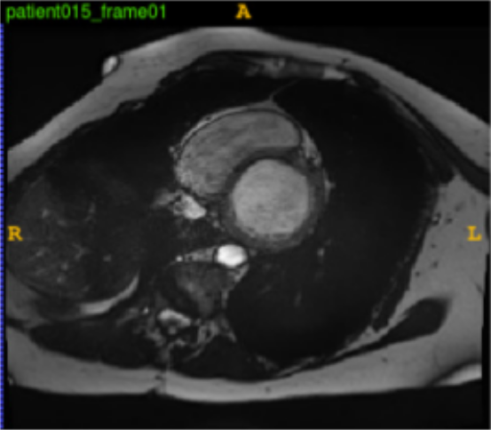
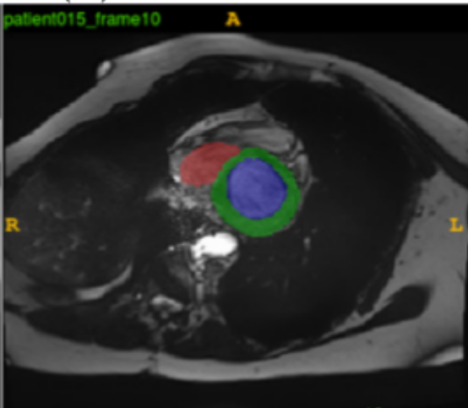
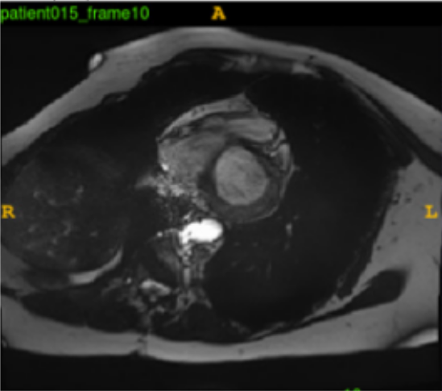
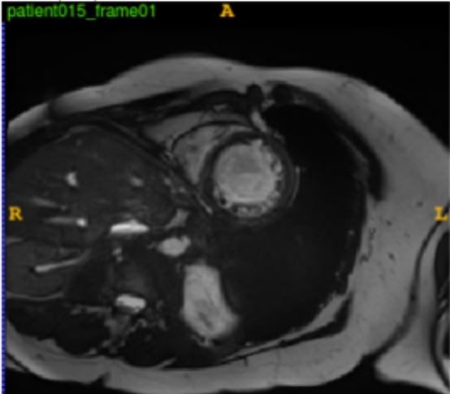
SegNet: A deep convolutional encoder-decoder architecture for image segmentation
Convolutional Encoder-Decode
Pooling Indices
DECODER
Input
ENCODER
Output
Segmentation
Conv + BN + ReLU
Pooling
Upsampling
Softmax
Eliminates the need for learning to up-sample
Keeps high frequency details intact by using unpooling method
Badrinarayanan et al., "Segnet: A deep convolutional encoder-decoder architecture for image segmentation.", CVPR, 2015

Slide 25
Unpooling
9 | 8
10 | 15
6 | 5 | 8 | 4
2 | 9 | 1 | 3
5 | 10 | 6 | 7
2 | 1 | 2 | 15
0 | 0 | 8 | 0
0 | 9 | 0 | 0
0 | 10 | 0 | 0
0 | 0 | 0 | 15
Max Pooling
Unpooling
11 | 00
01 | 11
Indices of Maximum value

Slide 26
U-NET: Convolutional networks for biomedical image segmentation
128
64
64
64
64
512²
512²
512²
512²
512²
512 X 512 X 2
512 X 512
256
128
128
128
256²
64
256²
256²
256²
256²
256²
512
256
256
256
128²
128²
128
128²
128²
128²
128²
512
512
1024
64²
64²
conv [3x3], ReLU
64²
64²
64²
512
256
64²
Max Pool [2x2]
1024
64²
32²
32²
32²
copy
Up Conv [2x2]
Conv [1x1]
Ronneberger, Olaf, Philipp Fischer, and Thomas Brox. "U-net: Convolutional networks for biomedical image segmentation." International Conference on Medical image computing and computer-assisted intervention. Springer, Cham, 2015.

Slide 27
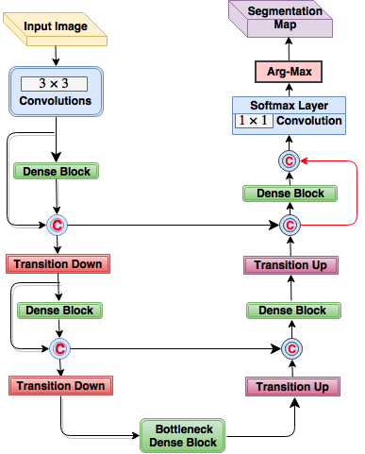
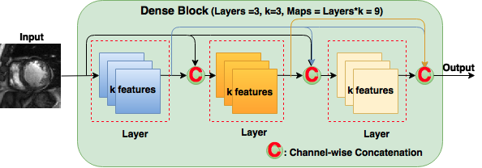
Fully convolutional DenseNets
Encoder path of the network is based on DenseNets
Each layer is directly connected to all other layers
Extensive feature reuse and parameter efficient

Slide 28
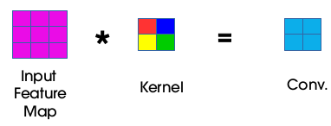
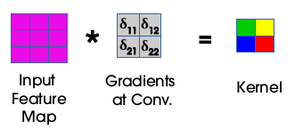
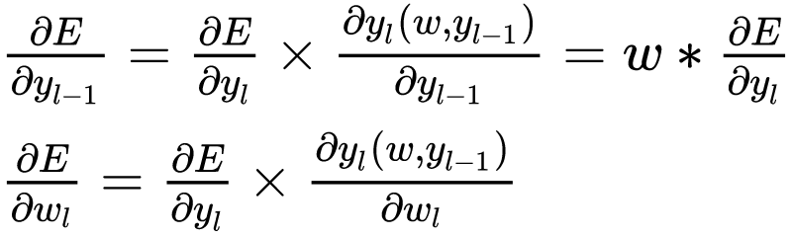
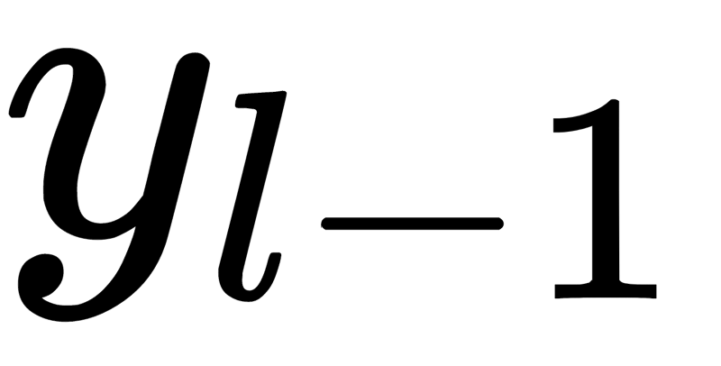
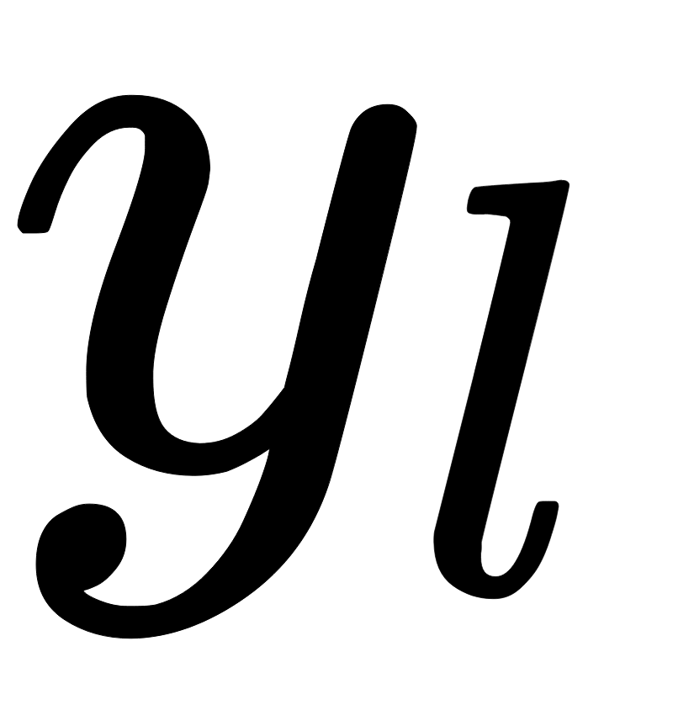
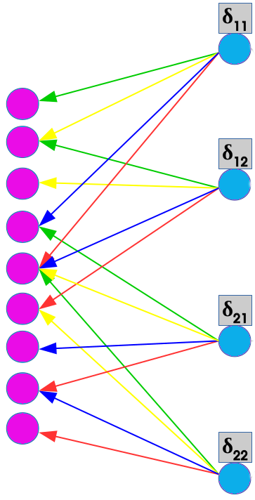
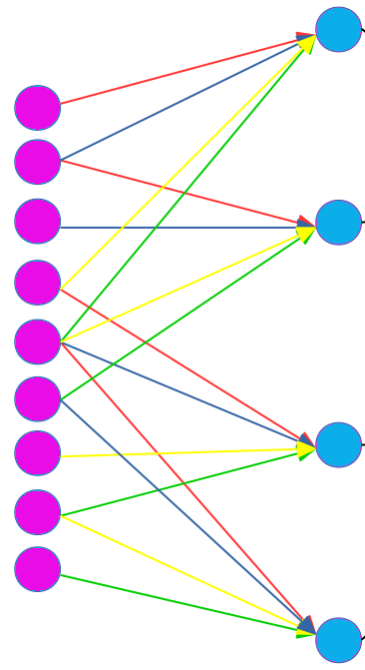

Backpropagation through CNN
Forward Pass
Backward Pass

